Slide 1
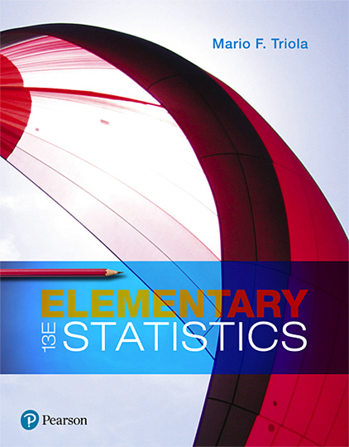
Elementary Statistics
Thirteenth Edition
Chapter 5
Probability Distributions
Copyright © 2018, 2014, 2012 Pearson Education, Inc. All Rights Reserved

Slide 2
Probability Distributions
5-1 Probability Distributions
5-2 Binomial Probability Distributions
5-3 Poisson Probability Distributions

Slide 3
Key Concept
This section introduces the concept of a random variable and the concept of a probability distribution.
We illustrate how a probability histogram is a graph that visually depicts a probability distribution.
We show how to find the important parameters of mean, standard deviation, and variance for a probability distribution.
Most importantly, we describe how to determine whether outcomes are significant (significantly low or significantly high).

Slide 4
Basic Concepts of Probability Distribution (1 of 4)
Random Variable
A random variable is a variable (typically represented by x) that has a single numerical value, determined by chance, for each outcome of a procedure.

Slide 5
Basic Concepts of Probability Distribution (2 of 4)
Probability Distribution
A probability distribution is a description that gives the probability for each value of the random variable. It is often expressed in the format of a table, formula, or graph.

Slide 6
Basic Concepts of Probability Distribution (3 of 4)
Discrete Random Variable
A discrete random variable has a collection of values that is finite or countable. (If there are infinitely many values, the number of values is countable if it is possible to count them individually, such as the number of tosses of a coin before getting heads.)

Slide 7
Basic Concepts of Probability Distribution (4 of 4)
Continuous Random Variable
A continuous random variable has infinitely many values, and the collection of values is not countable. (That is, it is impossible to count the individual items because at least some of them are on a continuous scale, such as body temperatures.)

Slide 8
Probability Distribution Requirements (1 of 2)
Every probability distribution must satisfy each of the following three requirements.
There is a numerical (not categorical) random variable x, and its number values are associated with corresponding probabilities.
∑P(x) = 1 where x assumes all possible values. (The sum of all probabilities must be 1, but sums such as 0.999 or 1.001 are acceptable because they result from rounding errors.)

Slide 9
Probability Distribution Requirements (2 of 2)
0 ≤ P(x) ≤ 1 for every individual value of the random variable x. (That is, each probability value must be between 0 and 1 inclusive.)

Slide 10
Example: Coin Toss (1 of 3)
Let’s consider tossing two coins, with the following random variable:
x = number of heads when two coins are tossed
The above x is a random variable because its numerical values depend on chance.
x: Number of Heads When Two Coins Are Tossed | P(x)
0 | 0.25
1 | 0.50
2 | 0.25

Slide 11
Example: Coin Toss (2 of 3)
With two coins tossed, the number of heads can be 0, 1, or 2, and the table is a probability distribution because it gives the probability for each value of the random variable x and it satisfies the three requirements listed earlier:
The variable x is a numerical random variable, and its values are associated with probabilities.
∑P(x) = 0.25 + 0.50 + 0.25 = 1
Each value of P(x) is between 0 and 1.

Slide 12
Example: Coin Toss (3 of 3)
The random variable x in the table is a discrete random variable, because it has three possible values (0, 1, 2), and three is a finite number, so this satisfies the requirement of being finite.
x: Number of Heads When Two Coins Are Tossed | P(x)
0 | 0.25
1 | 0.50
2 | 0.25

Slide 13
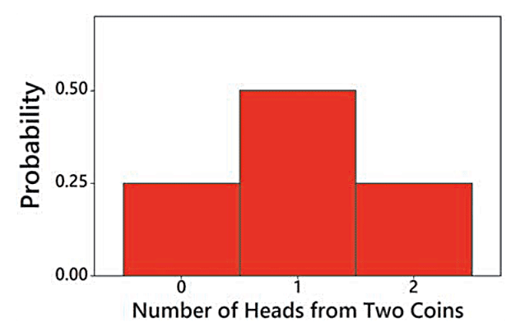
Probability Histogram: Graph of a Probability Distribution
A probability histogram is similar to a relative frequency histogram, but the vertical scale shows probabilities instead of relative frequencies based on actual sample results.
Probability Histogram for Number of Heads When Two Coins Are Tossed

Slide 14

Probability Formula
A probability distribution could also be in the form of a formula. Consider the formula
We find that P(0) = 0.25, P(1) = 0.50, and P(2) = 0.25. The probabilities found using this formula are the same as those in the table.

Slide 15
Example: Job Interview Mistakes (1 of 2)
Hiring managers were asked to identify the biggest mistakes that job applicants make during an interview, and the table below is based on their responses (based on data from an Adecco survey). Does the table below describe a probability distribution?
x | P(x)
Inappropriate attire | 0.50
Being late | 0.44
Lack of eye contact | 0.33
Checking phone or texting | 0.30
Total | 1.57

Slide 16
Example: Job Interview Mistakes (2 of 2)
Solution
The table violates the first requirement because x is not a numerical random variable. The “values” of x are categorical data, not numbers.
The table also violates the second requirement because the sum of the probabilities is 1.57, but that sum should be 1.
Because the three requirements are not all satisfied, we conclude that the table does not describe a probability distribution.

Slide 17
Parameters of a Probability Distribution (1 of 3)
Remember that with a probability distribution, we have a description of a population instead of a sample, so the values of the mean, standard deviation, and variance are parameters, not statistics.
The mean, variance, and standard deviation of a discrete probability distribution can be found with the following formulas:

Slide 18


Parameters of a Probability Distribution (2 of 3)
Mean, µ, for a probability distribution
Variance, σ², for a probability distribution
Variance, σ², for a probability distribution

Slide 19

Parameters of a Probability Distribution (3 of 3)
Standard deviation, σ, for a probability distribution

Slide 20
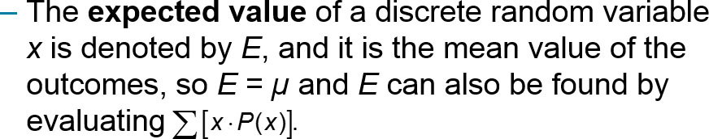
Expected Value (1 of 2)
Expected Value

Slide 21
Example: Finding the Mean, Variance, and Standard Deviation (1 of 5)
The table describes the probability distribution for the number of heads when two coins are tossed. Find the mean, variance, and standard deviation for the probability distribution described.
x: Number of Heads When Two Coins Are Tossed | P(x)
0 | 0.25
1 | 0.50
2 | 0.25

Slide 22
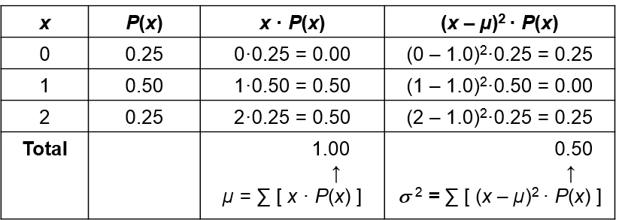
Example: Finding the Mean, Variance, and Standard Deviation (2 of 5)
Solution
The two columns at the left describe the probability distribution. The two columns at the right are for the purposes of the calculations required.

Slide 23
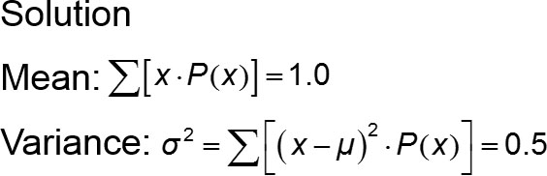
Example: Finding the Mean, Variance, and Standard Deviation (3 of 5)

Slide 24
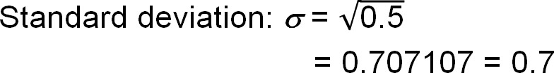
Example: Finding the Mean, Variance, and Standard Deviation (4 of 5)
Solution
The standard deviation is the square root of the variance, so

Slide 25
Example: Finding the Mean, Variance, and Standard Deviation (5 of 5)
Interpretation
When tossing two coins, the mean number of heads is 1.0 head, the variance is 0.50 heads², and the standard deviation is 0.7 head.
Also, the expected value for the number of heads when two coins are tossed is 1.0 head, which is the same value as the mean. If we were to collect data on a large number of trials with two coins tossed in each trial, we expect to get a mean of 1.0 head.

Slide 26
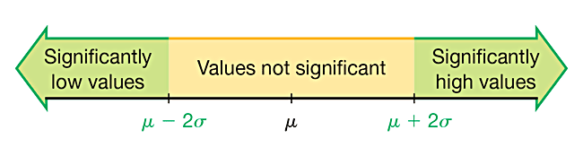
Identifying Significant Results with the Range Rule of Thumb
Range Rule of Thumb for Identifying Significant Values
Significantly low values are (µ − 2σ) or lower.
Significantly high values are (µ + 2σ) or higher.
Values not significant: Between (µ − 2σ) and (µ + 2σ).

Slide 27
Example: Identifying Significant Results with the Range Rule of Thumb (1 of 3)
We found that when tossing two coins, the mean number of heads is µ = 1.0 head and the standard deviation is σ = 0.7 head. Use those results and the range rule of thumb to determine whether 2 heads is a significantly high number of heads.

Slide 28
Example: Identifying Significant Results with the Range Rule of Thumb (2 of 3)
Solution
Using the range rule of thumb, the outcome of 2 heads is significantly high if it is greater than or equal to (µ + 2σ) . With µ = 1.0 head σ = 0.7 head, we get
(µ + 2σ) = 1 + 2(0.7) = 2.4 heads
Significantly high numbers of heads are 2.4 and above.

Slide 29
Example: Identifying Significant Results with the Range Rule of Thumb (3 of 3)
Interpretation
Based on these results, we conclude that 2 heads is not a significantly high number of heads (because 2 is not greater than or equal to 2.4).

Slide 30
Identifying Significant Results with Probabilities: (1 of 2)
Significantly high number of successes:
x successes among n trials is a significantly high number of successes if the probability of x or more successes is 0.05 or less. That is, x is a significantly high number of successes if P(x or more) ≤ 0.05.
The value 0.05 is not absolutely rigid. Other values, such as 0.01, could be used to distinguish between results that are significant and those that are not significant.

Slide 31
Identifying Significant Results with Probabilities: (2 of 2)
Significantly low number of successes:
x successes among n trials is a significantly low number of successes if the probability of x or fewer successes is 0.05 or less. That is, x is a significantly low number of successes if P(x or fewer) ≤ 0.05.
The value 0.05 is not absolutely rigid. Other values, such as 0.01, could be used to distinguish between results that are significant and those that are not significant.

Slide 32
The Rare Event Rule for Inferential Statistics
If, under a given assumption, the probability of a particular outcome is very small and the outcome occurs significantly less than or significantly greater than what we expect with that assumption, we conclude that the assumption is probably not correct.

Slide 33
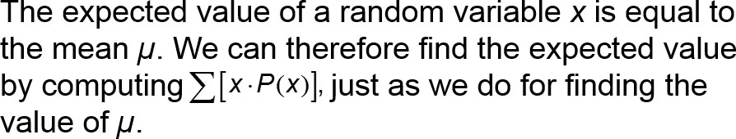
Expected Value (2 of 2)

Slide 34
Example: Be a Better Bettor (1 of 6)
You have $5 to place on a bet in the Golden Nugget casino in Las Vegas. You have narrowed your choice to one of two bets:
Roulette: Bet on the number 7 in roulette.
Craps: Bet on the “pass line” in the dice game of craps.

Slide 35
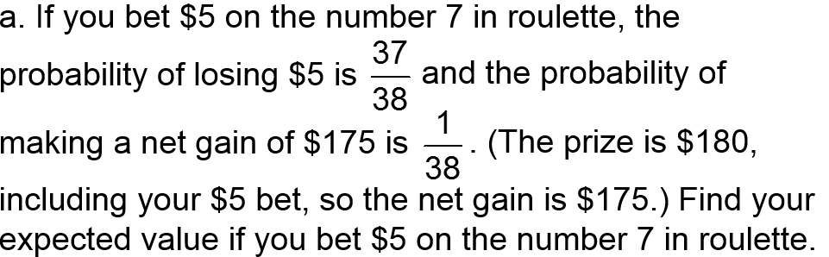
Example: Be a Better Bettor (2 of 6)

Slide 36
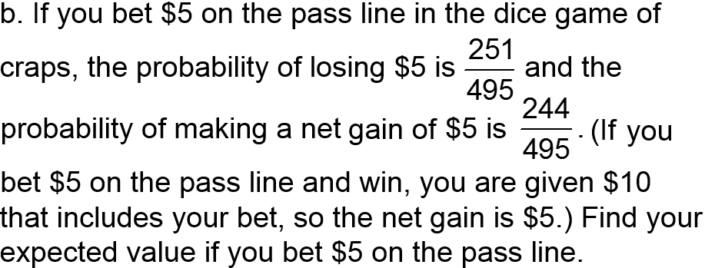
Example: Be a Better Bettor (3 of 6)
Which of the preceding two bets is better in the sense of producing higher expected value?

Slide 37
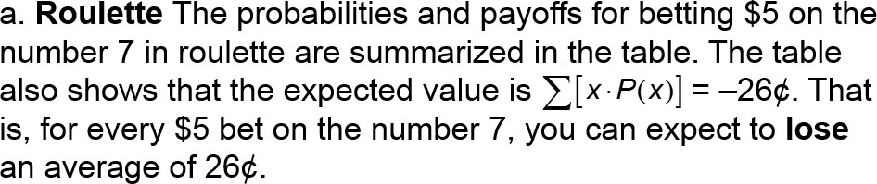
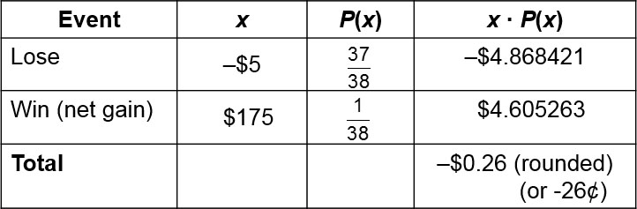
Example: Be a Better Bettor (4 of 6)
Solution

Slide 38
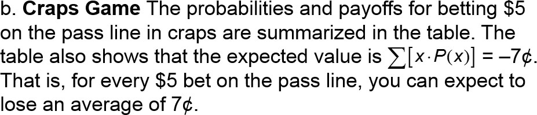
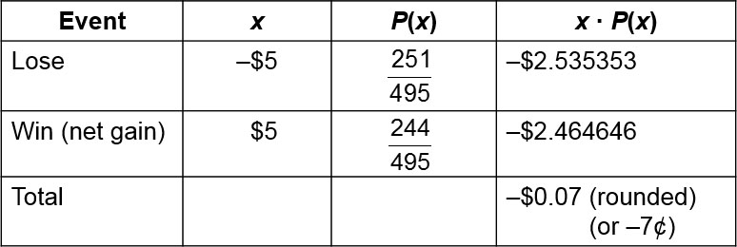
Example: Be a Better Bettor (5 of 6)
Solution

Slide 39
Example: Be a Better Bettor (6 of 6)
Interpretation
The $5 bet in roulette results in an expected value of −26¢ and the $5 bet in craps results in an expected value of −7¢. Because you are better off losing 7¢ instead of losing 26¢, the craps game is better in the long run, even though the roulette game provides an opportunity for a larger payoff when playing the game once.

